Slide 1
My journal to python
艾晨阳
4110E202
MY DEAR GREAT TEACHER
艾晨阳

Slide 2
AGENDA
Python Intro Python Tuples
Python Sets
Python Dictionaries
Python If..Else
Python While Loops
Python For Loops
Python Functions
Python Lambda
Pyhton Syntax
Python Comments
Python Variables
Python Data Types
Python Numbers
Python Casting
Python Strings
Python Booleans
Python Operators
Python List

Slide 3
What is Python?
Python is a popular programming language. It was created by Guido van Rossum, and released in 1991.
It is used for:
web development (server-side),
software development,
mathematics,
system scripting.
What can Python do?
Python can be used on a server to create web applications.
Python can be used alongside software to create workflows.
Python can connect to database systems. It can also read and modify files.
Python can be used to handle big data and perform complex mathematics.
Python can be used for rapid prototyping, or for production-ready software development.
Why Python?
Python works on different platforms (Windows, Mac, Linux, Raspberry Pi, etc).
Python has a simple syntax similar to the English language.
Python has syntax that allows developers to write programs with fewer lines than some other programming languages.
Python runs on an interpreter system, meaning that code can be executed as soon as it is written. This means that prototyping can be very quick.
Python can be treated in a procedural way, an object-oriented way or a functional way

Slide 4
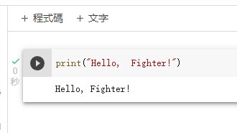
Good to know:
The most recent major version of Python is Python 3, which we shall be using in this tutorial.
However, Python 2, although not being updated with anything other than security updates, is still quite popular.
In this tutorial Python will be written in a text editor.
It is possible to write Python in an Integrated Development Environment, such as Thonny, Pycharm, Netbeans or Eclipse which are particularly useful when managing larger collections of Python files.
Example

Slide 5
PYTHON SYNTAX

Slide 6
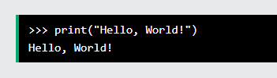

Python syntax can be executed by writing directly in the Command Line:
Or by creating a python file on the server, using the .py file extension, and running it in the Command Line:

Slide 7
Python Indentation
Indentation refers to the spaces at the beginning of a code line.
Where in other programming languages the indentation in code is for readability only, the indentation in Python is very important.
Python uses indentation to indicate a block of code.

Slide 8
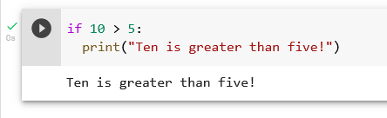
Python uses indentation to indicate a block of code.
Example

Slide 9
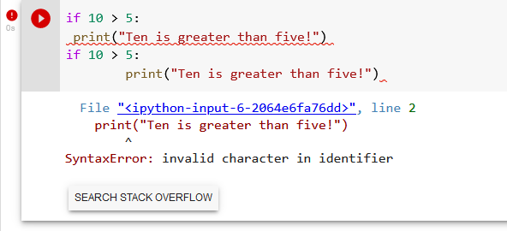
Python will give you an error if you skip the indentation:
Example

Slide 10
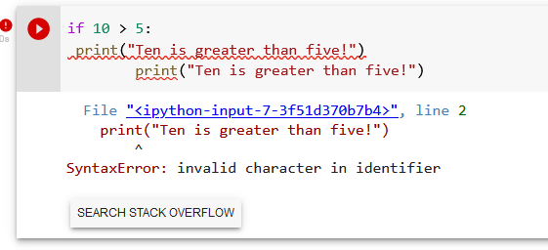
Example

Slide 11
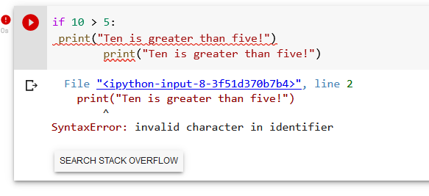
You have to use the same number of spaces in the same block of code, otherwise Python will give you an error:

Slide 12
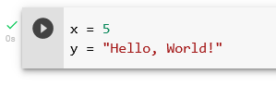
In Python, variables are created when you assign a value to it:
Example

Slide 13
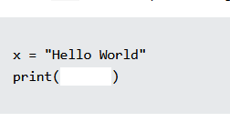
Python has no command for declaring a variable.
Comments
Python has commenting capability for the purpose of in-code documentation.
Comments start with a #, and Python will render the rest of the line as a comment:
Python has no command for declaring a variable.
Example

Slide 14
Python Variables
In Python, variables are created when you assign a value to it:

Slide 15
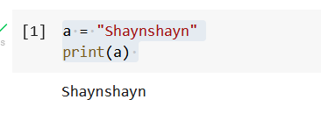
Example
Variable in python:
You will learn more about variables in the Python Variables chapter.

Slide 16

Comments
Python has commenting capability for the purpose of in-code documentation.
Comments start with a #, and Python will render the rest of the line as a comment:
Example

Slide 17
Comments can be used to explain Python code. Comments can be used to make the code more readable. Comments can be used to prevent execution when testing code.
Creating a Comment

Slide 18
Python Comments
Comments can be used to explain Python code.
Comments can be used to make the code more readable.
Creating a Comment

Slide 19
Comments can be used to explain Python code.
Comments can be used to make the code more readable.
Comments can be used to prevent execution when testing code.
Creating a Comment

Slide 20
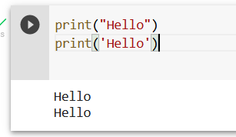
Comments can be placed at the end of a line, and Python will ignore the rest of the line:
Example

Slide 21
A comment does not have to be text that explains the code, it can also be used to prevent Python from executing code:

Slide 22
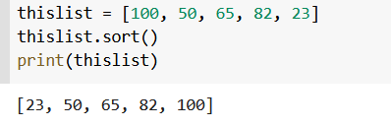
Multi Line Comments
Python does not really have a syntax for multi line comments.
To add a multiline comment you could insert a # for each line:
Example

Slide 23
Or, not quite as intended, you can use a multiline string.
Since Python will ignore string literals that are not assigned to a variable, you can add a multiline string (triple quotes) in your code, and place your comment inside it:
Example
As long as the string is not assigned to a variable, Python will read the code, but then ignore it, and you have made a multiline comment.

Slide 24
Python Variables
Variables
Variables are containers for storing data values.

Slide 25
Creating Variables
Python has no command for declaring a variable.
A variable is created the moment you first assign a value to it.
Example

Slide 26
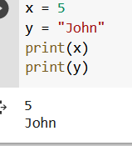
Variables do not need to be declared with any particular type, and can even change type after they have been set.
Example

Slide 27
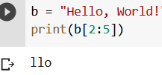
Casting
If you want to specify the data type of a variable, this can be done with casting.
Example

Slide 28
Python - Variable Names
Variable Names

Slide 29
A variable can have a short name (like x and y) or a more descriptive name (age, carname, total_volume). Rules for Python variables: A variable name must start with a letter or the underscore character
A variable name cannot start with a number
A variable name can only contain alpha-numeric characters and underscores (A-z, 0-9, and _ )
Variable names are case-sensitive (age, Age and AGE are three different variables)

Slide 30
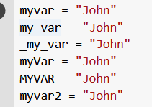
Example

Slide 31
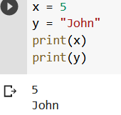
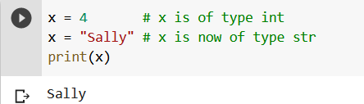
Pascal Case
Each word starts with a capital letter:
Snake Case
Each word is separated by an underscore character:

Slide 32
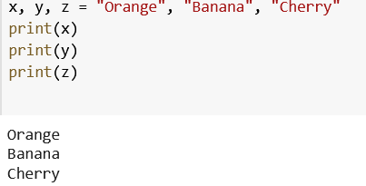
Python Variables - Assign Multiple Values
Many Values to Multiple Variables
Python allows you to assign values to multiple variables in one line:
Example

Slide 33

One Value to Multiple Variables
And you can assign the same value to multiple variables in one line:
Example

Slide 34
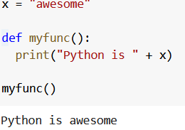
Unpack a Collection
If you have a collection of values in a list, tuple etc. Python allows you to extract the values into variables. This is called unpacking.
Example

Slide 35
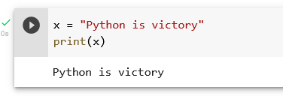
Python - Output Variables
Output Variables
The Python print() function is often used to output variables.
Example

Slide 36
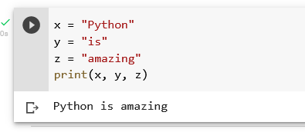
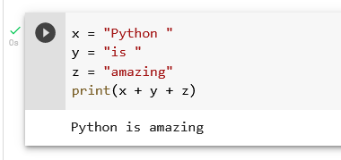
In the print() function, you output multiple variables, separated by a comma:
Example
You can also use the + operator to output multiple variables:
Example

Slide 37
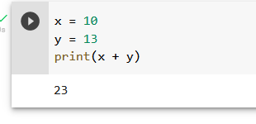
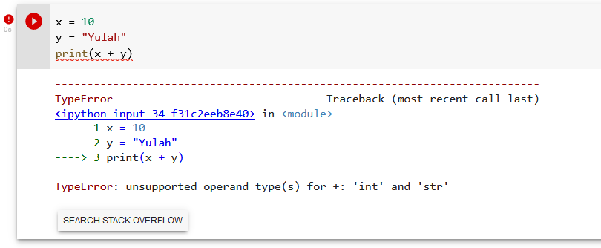
For numbers, the + character works as a mathematical operator:
Example
In the print() function, when you try to combine a string and a number with the + operator, Python will give you an error:
Example

Slide 38
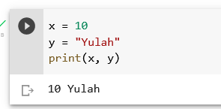
The best way to output multiple variables in the print() function is to separate them with commas, which even support different data types:
Example

Slide 39
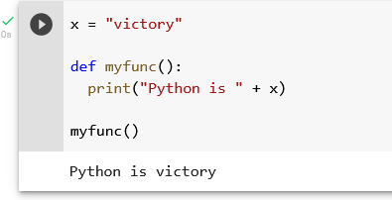
Python - Global Variables
Global Variables
Variables that are created outside of a function (as in all of the examples above) are known as global variables. Global variables can be used by everyone, both inside of functions and outside.
Example

Slide 40
If you create a variable with the same name inside a function, this variable will be local, and can only be used inside the function. The global variable with the same name will remain as it was, global and with the original value.
Example

Slide 41
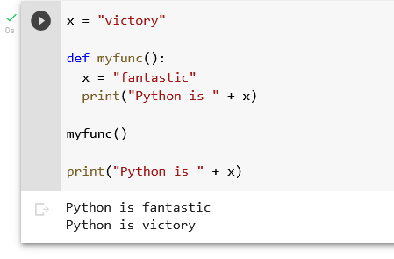
Create a variable inside a function, with the same name as the global variable

Slide 42
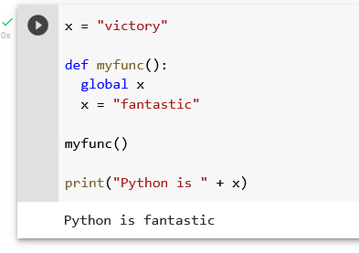
Also, use the global keyword if you want to change a global variable inside a function.
Example
To change the value of a global variable inside a function, refer to the variable by using the global keyword:

Slide 43
Python Data Types

Slide 44
Built-in Data Types
In programming, data type is an important concept.
Variables can store data of different types, and different types can do different things.

Slide 45
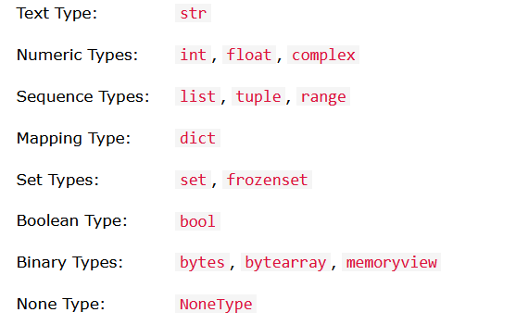
Python has the following data types built-in by default, in these categories:

Slide 46
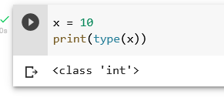
Getting the Data Type
You can get the data type of any object by using the type() function:
Example
Print the data type of the variable x:

Slide 47
Setting the Data Type

Slide 48
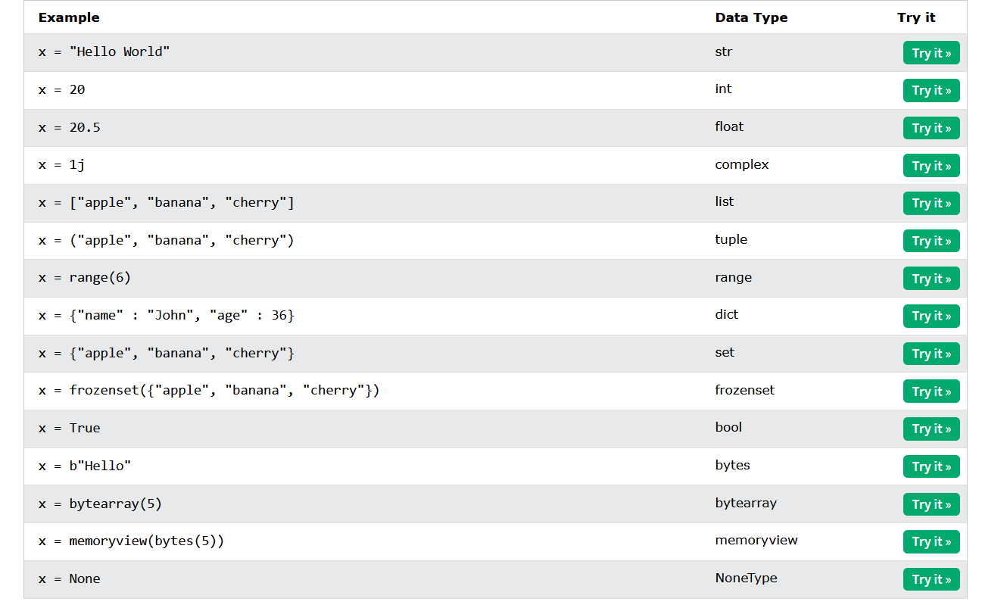
In Python, the data type is set when you assign a value to a variable:

Slide 49
Setting the Specific Data Type

Slide 50
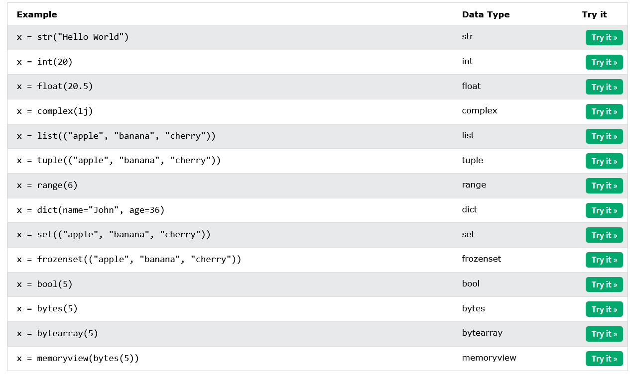
If you want to specify the data type, you can use the following constructor functions:

Slide 51
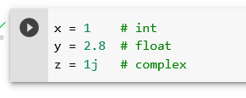
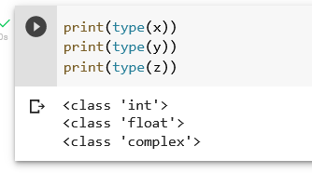
Python Numbers
There are three numeric types in Python: int float complex Variables of numeric types are created when you assign a value to them:
Example
To verify the type of any object in Python, use the type() function:

Slide 52
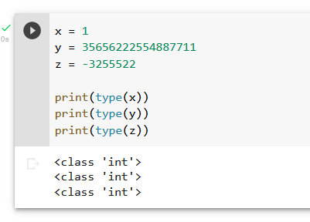
Int
Int, or integer, is a whole number, positive or negative, without decimals, of unlimited length.
Example
Integers

Slide 53
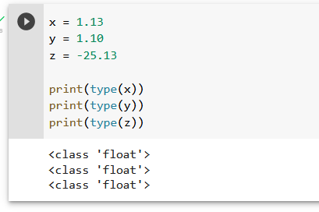
Float
Float, or "floating point number" is a number, positive or negative, containing one or more decimals.
Example

Slide 54
Float can also be scientific numbers with an "e" to indicate the power of 10.
Example
Float, or "floating point number" is a number, positive or negative, containing one or more decimals.

Slide 55
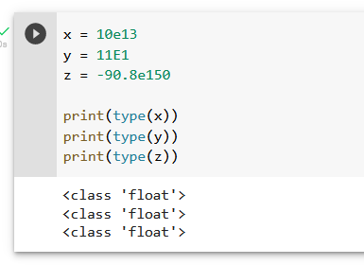
Float can also be scientific numbers with an "e" to indicate the power of 10.
Example
Float

Slide 56
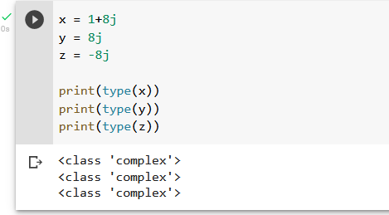
Complex
Complex numbers are written with a "j" as the imaginary part:
Example
Complex:

Slide 57
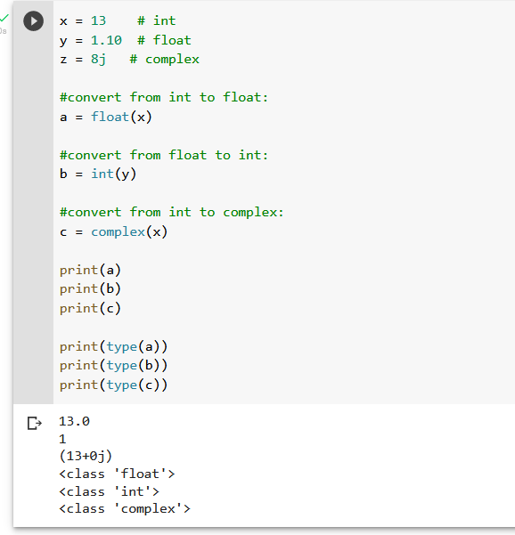
Type Conversion
You can convert from one type to another with the int(), float(), and complex() methods:
Example
Convert from one type to another:

Slide 58
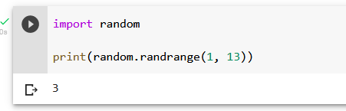
Random Number
Python does not have a random() function to make a random number, but Python has a built-in module called random that can be used to make random numbers:
Example
Import the random module, and display a random number between 1 and 9:

Slide 59
Python Casting

Slide 60
Specify a Variable Type

Slide 61
There may be times when you want to specify a type on to a variable. This can be done with casting. Python is an object-orientated language, and as such it uses classes to define data types, including its primitive types.
Casting in python is therefore done using constructor functions:
int() - constructs an integer number from an integer literal, a float literal (by removing all decimals), or a string literal (providing the string represents a whole number)
float() - constructs a float number from an integer literal, a float literal or a string literal (providing the string represents a float or an integer)
str() - constructs a string from a wide variety of data types, including strings, integer literals and float literals

Slide 62

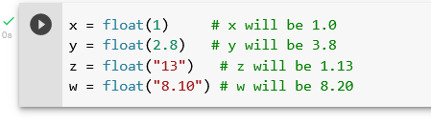
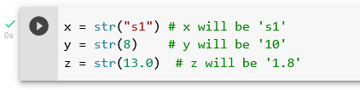
Example
Integers:
Floats:
Strings:

Slide 63
Python Strings

Slide 64
Strings
Strings in python are surrounded by either single quotation marks, or double quotation marks.
'hello' is the same as "hello".

Slide 65
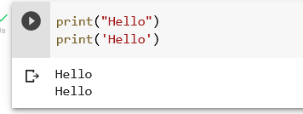
You can display a string literal with the print() function:
Example

Slide 66
Assign String to a Variable

Slide 67
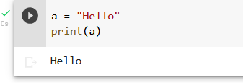
Assigning a string to a variable is done with the variable name followed by an equal sign and the string:
Example

Slide 68
Multiline Strings

Slide 69
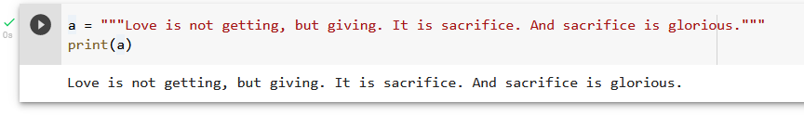
You can assign a multiline string to a variable by using three quotes:
Example
You can use three double quotes:

Slide 70
Or three single quotes:
Example

Slide 71
Strings are Arrays

Slide 72
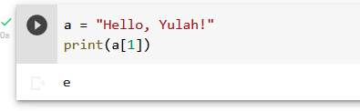
Like many other popular programming languages, strings in Python are arrays of bytes representing unicode characters.
However, Python does not have a character data type, a single character is simply a string with a length of 1.
Square brackets can be used to access elements of the string.
Example
Get the character at position 1 (remember that the first character has the position 0):

Slide 73
Looping Through a String

Slide 74
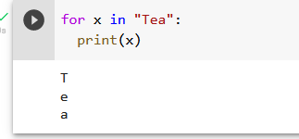
Since strings are arrays, we can loop through the characters in a string, with a for loop.
Example
Loop through the letters in the word “square":

Slide 75
String Length

Slide 76
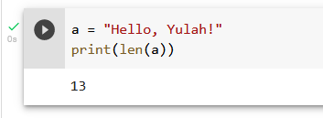
To get the length of a string, use the len() function.
Example
The len() function returns the length of a string:

Slide 77
Check String
To check if a certain phrase or character is present in a string, we can use the keyword in.

Slide 78
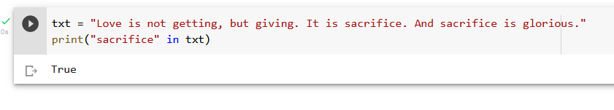
Example
Check if “sacrifice" is present in the following text

Slide 79
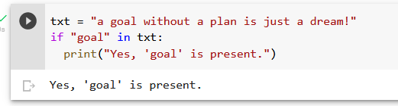
Use it in an if statement:
Example
Print only if “sacrifice" is present:

Slide 80
Check if NOT
To check if a certain phrase or character is NOT present in a string, we can not in.

Slide 81
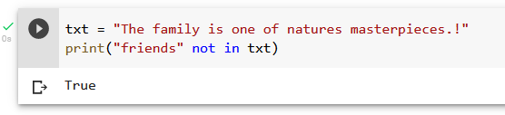
Example
Check if “Family" is NOT present in the following text:

Slide 82

Use it in an if statement:
Example
print only if “friendship" is NOT present:

Slide 83
Python - Slicing Strings

Slide 84

Example
Get the characters from position 2 to position 5 (not included):

Slide 85
Slicing
You can return a range of characters by using the slice syntax.
Specify the start index and the end index, separated by a colon, to return a part of the string.

Slide 86
Slice From the Start
By leaving out the start index, the range will start at the first character:

Slide 87

Example
Get the characters from position 2, and all the way to the end:

Slide 88
Negative Indexing
Use negative indexes to start the slice from the end of the string:

Slide 89

Example
Get the characters:
From: “l" in “Yulah!" (position -5)
To, but not included: “h" in “Yulah!" (position -2)

Slide 90
Python - Modify Strings
Python has a set of built-in methods that you can use on strings.

Slide 91

Upper Case
Example
The upper() method returns the string in upper case:

Slide 92
Lower Case

Slide 93

Example
The lower() method returns the string in lower case:

Slide 94
Remove Whitespace
Whitespace is the space before and/or after the actual text, and very often you want to remove this space.

Slide 95

Example
The strip() method removes any whitespace from the beginning or the end:

Slide 96
Replace String

Slide 97

Example
The replace() method replaces a string with another string:

Slide 98
Split String
The split() method returns a list where the text between the specified separator becomes the list items.

Slide 99

Example
The split() method splits the string into substrings if it finds instances of the separator:

Slide 100
Python - String Concatenation
String Concatenation
To concatenate, or combine, two strings you can use the + operator.

Slide 101

Example
Merge variable a with variable b into variable c:

Slide 102

Example
To add a space between them, add a " ":

Slide 103
Python - Format - Strings

Slide 104

As we learned in the Python Variables chapter, we cannot combine strings and numbers like this:
Example

Slide 105

Example
Use the format() method to insert numbers into strings:

